Slide 1




NEXT GEN EMPLOYABILITY PROGRAM
Creating a future-ready workforce
Team Members
College Name
Student Name :J.vijaya
Student ID :au951221104058
JP College Of Engineering

Slide 2

CAPSTONE PROJECT SHOWCASE
Project Title
Voting Web Application using Django Framework
Abstract | Problem Statement | Project Overview | Proposed Solution | Technology Used | Modelling & Results | Conclusion

Slide 3
Abstract
Empower your voice with our Django-based voting web application. Seamlessly designed for ease of use, our platform enables users to participate in various polls and elections effortlessly. With intuitive interfaces and robust security measures, voters can trust in the integrity of their choices. From community decisions to organizational elections, our platform fosters democracy and inclusivity. Join us in shaping the future, one vote at a time.
Source :

Slide 4
Problem Statement
The current absence of a user-friendly and secure platform for conducting online voting processes poses significant challenges to democratic participation. To address this, the development of a voting web application using Django is essential. This application aims to provide an intuitive interface for voters, ensure the security and integrity of the voting process, and promote inclusivity by accommodating various types of elections. The problem statement entails designing and implementing a Django-based solution that facilitates convenient, trustworthy, and accessible online voting experiences.
Source :

Slide 5
Project Overview
"Our project involves developing a robust and user-friendly online voting application using the Django framework. This application aims to streamline the voting process, ensuring accessibility, security, and transparency for users.
Key features of the application include:
User Registration and Authentication: Users can create accounts securely and authenticate their identity to access the voting platform.
Poll Creation and Management: Administrators can create and manage polls for various types of elections, specifying options and voting parameters.
Secure Voting: Voters can cast their ballots securely through the platform, with measures in place to prevent tampering and ensure anonymity.
Real-time Results: The application provides real-time updates on voting results, allowing stakeholders to track the progress of elections.
Accessibility and Inclusivity: The platform is designed to accommodate diverse users, including those with disabilities, ensuring equal participation for all.

Slide 6
Proposed Solution
.
User Authentication and Registration: Implement a robust user authentication system where users can register securely and log in to access the voting functionalities.
Poll Creation and Management: Allow authorized administrators to create and manage polls. They can define the details of each poll, including the title, description, options, and duration.
Voter Interface: Design an intuitive interface for voters to view available polls, read descriptions, and cast their votes. Ensure accessibility features for users with disabilities.
Vote Casting: Implement mechanisms to ensure the security and integrity of the voting process. Each user should be able to cast only one vote per poll, and the system should maintain anonymity and prevent tampering.
Real-time Updates: Provide real-time updates on the progress of ongoing polls and display results after the voting period ends. Ensure transparency by showing the number of votes cast for each option.
:

Slide 7
Advantages
Django for a voting web application is its robust security features.
Django provides built-in protection against common security threats such as cross-site scripting (XSS), cross-site request forgery (CSRF), and SQL injection. By leveraging Django's security features, developers can ensure that the voting web application is less vulnerable to attacks, safeguarding the integrity of the voting process and protecting user data..
Source :

Slide 8
Disadvantages
Django for a voting web application is the learning curve for developers who are not familiar with the framework.
Django has a steep initial learning curve, especially for those who are new to web development or the Python programming language.
This may require additional time and resources for developers to become proficient in Django's concepts, architecture, and best practices before they can effectively build and maintain the voting application. Additionally, because Django is a full-stack framework with a wide range of features, developers may need to invest time in understanding and configuring only the necessary components relevant to the voting application, which could potentially lead to some overhead.
Source :

Slide 9




Technology Used
Front-end
Back-end
Source :

Slide 10
Modelling & Results
In developing a voting application using Django, meticulous attention is directed towards both modeling the underlying data structure and effectively presenting the voting results to users.
Through Django's model system, the application's data architecture is meticulously crafted, typically featuring models like Question and Choice to represent the polls and available choices.
Once users have participated in the voting process, conveying the results to them becomes paramount.
Leveraging Django's templating system, the application dynamically generates HTML templates that vividly present the voting outcomes in an intuitive and visually engaging manner.
Furthermore, the application may utilize charting libraries or custom visualization techniques to elucidate the distribution of votes across different options, offering users valuable insights into the voting process's outcome.
Source :

Slide 11
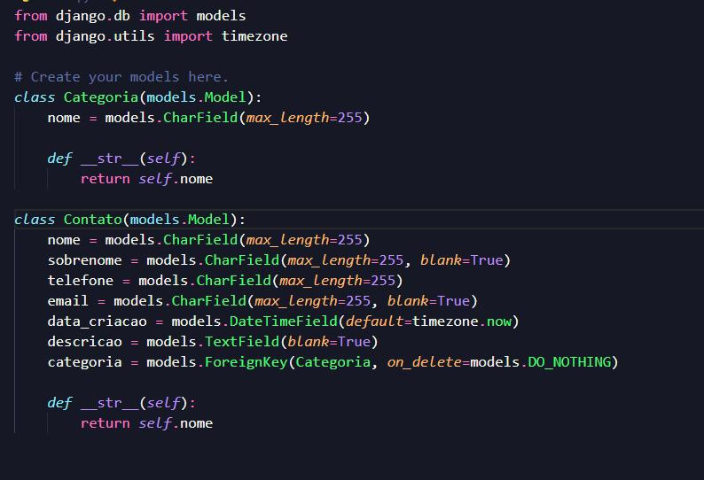
Homepage

Slide 12
About-Us-Page
1.Credibility: The "About Us" page establishes credibility by providing informationabout the organization's history, mission, and team members .
2.Mission and Values: It communicates the organization's mission, values, and objectivesin promoting democratic participation and decision-making.
3. Community Engagement: The page showcases the organization's commitment tocommunity engagement and empowerment through the voting process, inspiring active participation.
4. Contact Information: Users can easily reach out with questions, feedback, or inquiriesabout the voting application through the contact information provided on the page.

Slide 13
Service-Page
Header Section
Introduction section
User Services
Administrator Services
Organizational Services
Technical Services
Consulting Services
Call to Action Services

Slide 14
Departments-Page
Header Section
● Introduction Section
● Department Listings
● Department Details
● Key Personnel
● Collaboration Opportunities
● Footer Section

Slide 15
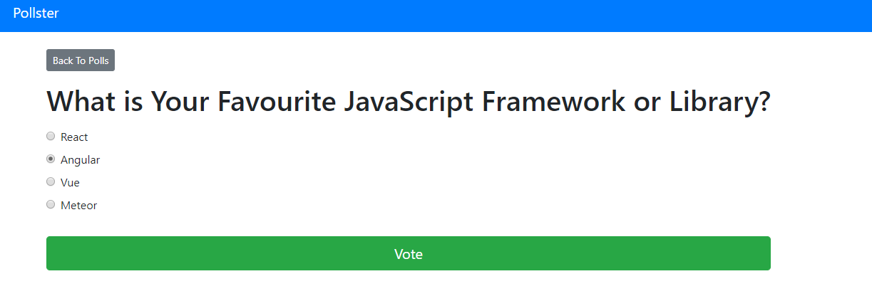
Blog-Page

Slide 16
Future Enhancements:
Utilize machine learning algorithms to analyze voting data, predict future trends, and provide personalized recommendations for users based on their voting history and preferences
Extend the voting application's reach by developing native mobile apps for iOS and Android platforms, offering a seamless and optimized experience for mobile users.
Explore integrating blockchain technology to enhance the transparency, security, and integrity of the voting process, ensuring that votes are immutable and tamper-proof.
Implement comprehensive reporting functionalities for administrators to generate detailed reports on voting patterns, demographics, and trends. This could include visualizations such as charts and graphs.

Slide 17
Conclusion
In conclusion, building a voting web application using the Django framework offers a solid foundation for creating a secure, scalable, and user-friendly platform. With Django's built-in features and extensive ecosystem of libraries and tools, developers can efficiently implement key functionalities such as user authentication, data modeling, and web templating. Overall, Django provides a robust framework for developing a voting web application that empowers users to participate in democratic processes effectively while ensuring the integrity and fairness of the voting process.
Source :

Slide 18
Thank You!
Notes:
Thank You !!

